Slide 1

Team Introduction
Week 03
Team Introduction and Tentative Project Proposal
Team 07
Department of Artificial Intelligence Cyber Security
College of Science & Technology

Slide 2
Contents
Member Introduction
Project Proposal
Language and Environment

Slide 3
Member Introduction

Slide 4

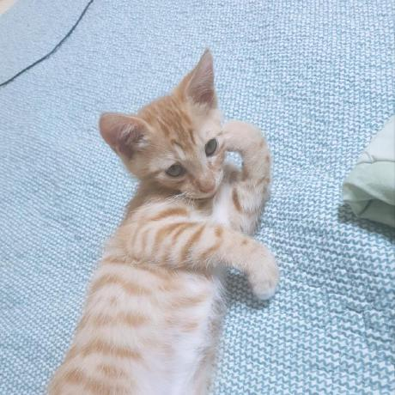
Members
Taegeom Oh_2020271341
Speaker
Department of Artificial Intelligence Cyber Security
Capability in SW dev C, C++
Usable Environment Windows
https://github.com/ose1202 ose1202@korea.ac.kr
Geunho Kim _2022270122
Responsible for Presentation
Department of Artificial Intelligence Cyber Security
Capability in SW dev C, C++, JAVA, Python
Usable Environment Windows, Debian, Redhat
https://github.com/Gina90160 thomasho01@korea.ac.kr

Slide 5
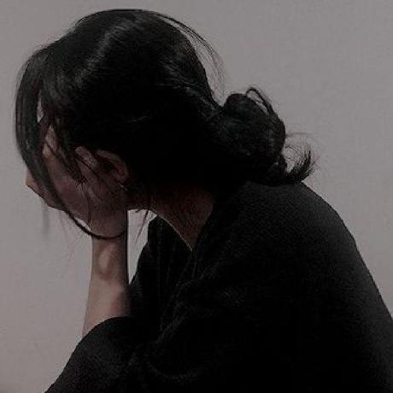
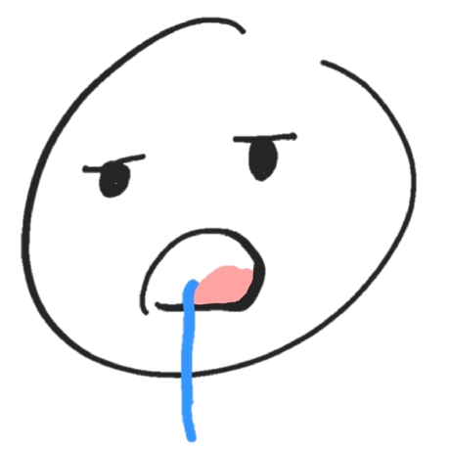
Members
Minse Kim_2022270121
Developer
Department of Artificial Intelligence Cyber Security
Capability in SW dev C, C++, JavaScript, Python
Usable Environment Windows, Mac, Linux
https://github.com/s3min141 minse0204@korea.ac.kr
Hajun Myung_2022270033
Developer
Division of Applied Mathematical Sciences Major in Data Computational Sciences
Capability in SW dev C, C++, JavaScript, Python
Usable Environment Windows, Mac, Linux
https://github.com/hajun-myoung hajun99@korea.ac.kr

Slide 6

Members
Minchan Park_2022270118
Developer
Department of Artificial Intelligence Cyber Security
Capability in SW dev C++
Usable Environment Mac
https://github.com/m0ngrels stin@korea.ac.kr

Slide 7
Project Proposal

Slide 8
Project Proposal
Real-time Signal Data Scaling
Huffman Coding https://lipcoder.tistory.com/187
Tree Structure

Slide 9
Language and Environment
Language
Python, C (In necessary)
Environment
Repository https://github.com/hajun-myoung/aics201-23-team7
Anaconda3

